Slide 1
Stress, Fatigue, and Injury Risk in Loggers and Log Truck Drivers: A Mixed Methods Study
Allison Clonch, Marcy Harrington, Marissa Baker, Lily Monsey, June Spector
Notes:
Marissa

Slide 2
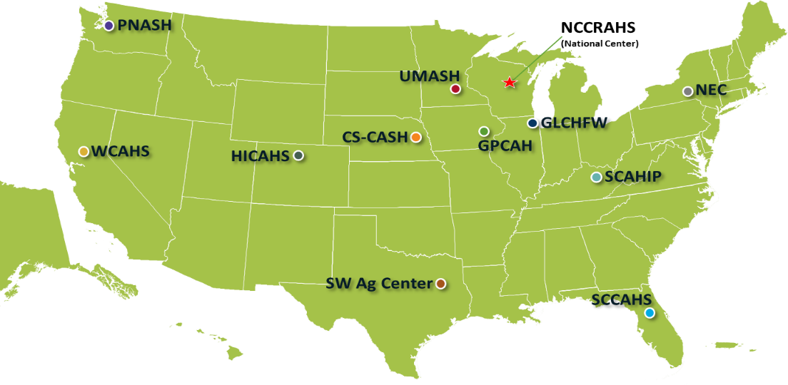

Slide 3
Background
Log truck drivers: a high risk and understudied population
Concern after cluster of log trucking fatalities in Idaho
Logging is one of the most dangerous industries
Fatality rate 30x higher than all other US workers
Fatigue is the leading contributor to transportation accidents
Work scheduling and job demands → stress and fatigue
Previous research found that fatal log truck accidents are increasing
Few specific studies on injury and fatality log truck drivers
Notes:
Previous research found that fatal log truck accidents are increasing
– Scott Barrett

Slide 4
WHAT TRAINING TOPICS WOULD BE MOST USEFUL TO IMPROVE SAFETY? (PRIORITY TOP 3)
 | OR | WA | ID
SAFETY LEADERSHIP | 25% | 30% | 17%
CHAINSAW USE & MAINTENCE | 9% | 7% | 7%
OTHER EQUIPMENT MAINTENANCE | 5% | 9% | 14%
DANGER TREES | 9% | 10% | 11%
FATIGUE & STRESS | 20% | 13% | 24%
FITNESS & HEALTH | 12% | 14% | 10%
GUARDING & LOCK-OUT/TAG-OUT | 5% | 10% | 7%
KNOWING BEST PPE OPTIONS | 9% | 5% | 5%
Notes:
Polling of 425 members identified: 1) Safety Needs (training new workers, room on landing zones, mechanized logging, location awareness); 2) Hazards (difficult terrain, woods roads, cutting, fatigue); 3) Health Issues (chronic back, muscle, or joint pain, poor sleep, hearing loss); and 4) Training Interests (fatigue, safety leadership, danger trees, fitness)
Safety leadership was most needed at 25% but combined needs for fitness & health plus fatigue & stress reached 32%.

Slide 5
Study Aims
Survey loggers and log truck drivers – work schedules, sleep, fatigue, stress, and job satisfaction
Interview log truck drivers and industry experts - needs, challenges, and solutions
Review and vet existing data sources – fatal and non-fatal log truck crashes in Federal Region X + MT
Notes:
Marissa

Slide 6
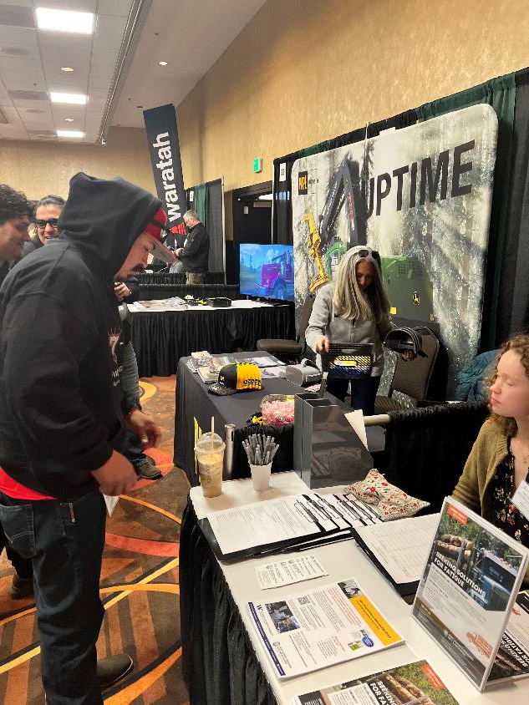
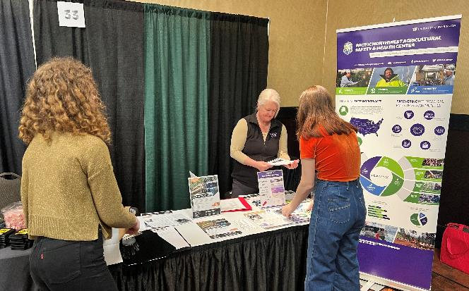
Methods - Recruitment
Notes:
Marissa

Slide 7
Results – Survey & Interviews
46 logger & log truck driver surveys
9 in-depth interviews
48% of respondents were owner/operators
44% worked in the logging industry more than 25 years
49% of respondents work more than 55 hrs/week
21% start their workday between 1:30am-4:30am
Notes:
Marissa

Slide 8
Results – Job Demands & Support
Low stress, good health, strong job support & satisfaction
93% rate work high paced
37% didn’t take any breaks
I like just the freedom of being able to line out my own day, do what I want during the day, and haul logs for who I want to a certain extent. Just being independent.
I wanted to get an extra load more than anybody and make more than anybody and be successful and more successful, maybe, than my competitors, do better and just work harder, and it's kind of a prideful thing.
Notes:
High job satisfaction compared to many other trades!
(Self and System) pressure to work longer hours and faster

Slide 9
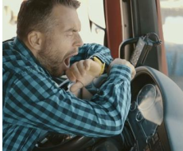
Results – Fatigue & Sleep
76% feel sleepy during work
67% get 5-7 hours of sleep; 9% less than 5 hours of sleep
More likely to use caffeine than taking a rest break
Most had no training on fatigue management
At some point every day, I'm like, "Oh, I'm kind of tired." And sometimes that's just a kind of a mental kind of noticing that my body and my mind is tired and my eyes might be tired.
Notes:
High job satisfaction compared to many other trades!
Limitation: Small sample size, geographically limited, lack of detail in crash reporting on road conditions or driver condition
(Self and System) pressure to work longer hours and faster

Slide 10
Results – Loggers Exchange Log Trucking Claims 2011-2021 (334 claims)
Top cause: overexertion, struck by object, falls
Top injuries: strains, contusions, fractures
60% claims from log truck drivers aged 45-64
58% those employed less than 3 years
24% collision and 76% non-collision related
Crashes top causes: Road/HWY (75%) vs. logging road, other vehicle, slick conditions
Notes:
There is a lack of detail to drill down to root causes such at fatigue. Only a couple of cases reported fatigue or falling asleep at the wheel.

Slide 11
Methods—MCMIS Analysis
Used federal data on log truck crashes
Motor Carrier Management Information System (MCMIS)
Data from 2015 – 2019
Washington, Oregon, Idaho, Montana
Used statistics to pinpoint important characteristics of crashes
Interested in factors of crashes resulting in injury or fatality
Notes:
Ally

Slide 12
Results – MCMIS Analysis
From 2015-2019, there were:
647 total crashes
219 (34%) resulted in injury/fatality
428 (66%) had no injury/fatality
Crashes in Oregon and Washington were less likely to result in injury/fatality compared to other states (OR = 0.53 and 0.14)
Crashes on roads with a median barrier were less likely to result in injury/fatality (OR = 0.53)
Notes:
There is a lack of detail to drill down to root causes such at fatigue. Only a couple of cases reported fatigue or falling asleep at the wheel.

Slide 13
Discussion - MCMIS Analysis
Results indicate higher incidence of crashes resulting in injury/fatality in Idaho and Montana
More information and research needed to understand the reason for this
Weather, light condition, time of day, and # of employees were not significant
Data restricted to environmental/physical factors
No information on drivers, speed, etc.
Notes:
Ally

Slide 14
Discussion – Industry Support - long days/long travel and fair rates
We've tried to get the mills to change their unloading hours. This would make a huge difference.... some of them were starting to unload at 4, 5 in the morning…They can get more sleep and be in sync with the rest of the community and the rest of their family.
…these haul rates suck. So why not just come out in the open and say, "I like you, buddy and I love to help you out, but your haul rates are such that I won't be hauling for you unless you bump up your rates.
...[A] group of truckers that were delivering one of the sawmills were able to collaborate together, cooperate together, and basically ease up enough. And then with that, asking the sawmill to say, "Hey, this is how many trips we can get." And so they eased up.
Notes:
Limitation: Small sample size, geographically limited, lack of detail in crash reporting on road conditions or driver condition

Slide 15
Discussion - Safety Communication & Leadership
Does talking the talk matter?
Notes:
Does talking the talk matter? Effects of supervisor safety communication and safety climate on long-haul truckers' safety performance. Huang YH, Sinclair RR, Lee J, McFadden AC, Cheung JH, Murphy LA. Accid Anal Prev. 2018 Aug;117:357-367. doi: 10.1016/j.aap.2017.09.006. Epub 2018 Feb 28. PMID:29500055
Safety communication had both main and moderating effects on safety behavior that ultimately predicted truck drivers' injury rates
Safety training with your crews, including independent operators/drivers, WORKS!
https://pubmed.ncbi.nlm.nih.gov/29500055/
This study examines the distinct contribution of supervisory safety communication and its interaction with safety climate in the prediction of safety performance and objective safety outcomes. Supervisory safety communication is defined as subordinates' perceptions of the extent to which their supervisor provides them with relevant safety information about their job (i.e., top-down communication) and the extent to which they feel comfortable discussing safety issues with their supervisor (i.e., bottom-up communication). Survey data were collected from 5162 truck drivers from a U.S. trucking company with a 62.1% response rate. Individual employees' survey responses were matched to their safety outcomes (i.e., lost-time injuries) six months after the survey data collection. Results showed that the quality of supervisor communication about safety uniquely contributes to safety outcomes, above and beyond measures of both group-level and organization-level safety climate. The construct validity of a newly-adapted safety communication scale was demonstrated, particularly focusing on its distinctiveness from safety climate and testing a model showing that communication had both main and moderating effects on safety behavior that ultimately predicted truck drivers' injury rates. Our findings support the need for continued attention to supervisory safety communication as an important factor by itself, as well as a contingency factor influencing how safety climate relates to safety outcomes.

Slide 16
Employer-level Safety Solutions
If we don't feel something's safe, we're more than welcome to say, "That's not safe." We're expected to come up with a way to do it safely. We're still expected to do the job, but we're welcome to seek a better way to do it.
One thing that I get that I think some other log truckers don't get is more variety, where I get to run the log loader sometimes or help out running the dozer. I think other guys don't get that as much, and I do enjoy that, being able to have some variety.
Notes:
ally

Slide 17
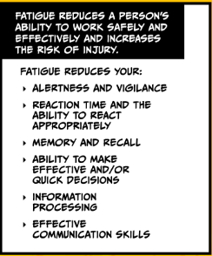
Fatigue Management
Prioritize sleep (7-8 hours)
Consistent routine
Recognize signs of tiredness
Strategic caffeine use
Take a rest
Nap 20-30 min!
Physical activity
Bright light
Noise
Notes:
The impact of short night-time naps on performance, sleepiness and mood during a simulated night shift: Chronobiology International: Vol 33, No 6 (tandfonline.com)
The 30-min nap significantly improved subjective sleepiness compared to the 10-min nap and no-nap control (p < 0.05). The 10-min nap significantly worsened negative mood compared to the 30-min nap and no-nap control (p < 0.01
PNASH recommendations at https://deohs.washington.edu/pnash/index.php/blog/fatigue-management

Slide 18
Next Steps
Expand analysis to other logging regions and data
Fatigue management training
Share the message
High job satisfaction!
Need industry solutions for long hours / haul rates
Notes:
ally

Slide 19
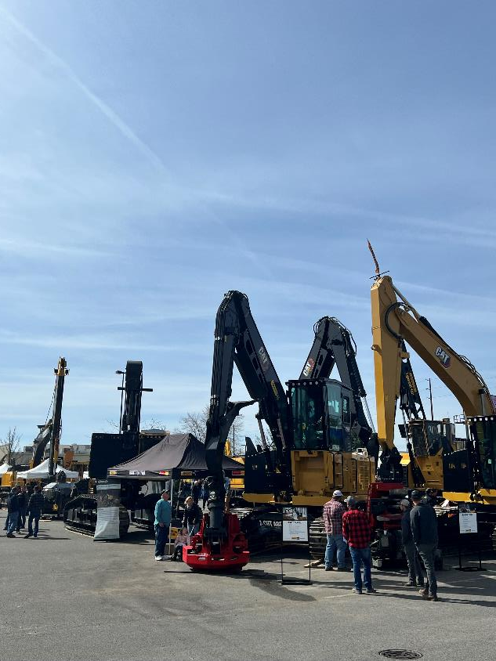
Acknowledgements
Stan Leach, Idaho Logging Safety Program
Steve Barham, Assoc. Logging Contractors
John Graham, Assoc. Loggers Exchange
Intermountain Logging Conference
UW Statistical Consulting Service
Notes:
Ally

Slide 20
Questions & Ideas?

