Slide 1
Introduction: This air quality curriculum is intended for an informal learning environment. This curriculum was used in an after-school program with high school students mentored by undergraduate students. The program focused on preparing students to conduct their own research on particulate matter, with guidance from university researchers. The curriculum has three main components: 1. Materials for conducting particulate matter research using low-cost sensors 2. PowerPoint slides on air quality topics 3. Experiential learning activities Components 1 and 3 are included in a separate file (Word document), while the PowerPoint slides are included here. The material here uses the Purple Air monitor, although this can easily be adapted for other low-cost PM sensors.
Air Quality curriculum
for a high school after-school program
Contents:
Slide 2
Air monitoring introduction
Slide 9
Purple Air introduction
Slide 15
Particle sizes and light scattering
Slide 20
Sources of particulate matter
Slide 24
Air pollution and health
Slide 34
Air quality case study: Tacoma and Pierce County - part 1
Slide 40
Air quality case study: Tacoma and Pierce County - part 2
Slide 44
Purple Air data
Slide 49
Forming hypotheses
Slide 54
Review of graphs
Slide 62
Time scales
Notes:
Authors: Elena Austin, Jessica Black, Kris Hartin, Jose Figueroa, Orly Stampfer, Maria Tchong-French, Omar Torres We are grateful for ideas and feedback from: Jacob Billy, Coalby Carner-Valicoff, Shelby Clark, Cristy Fiander, Aiyana Holt-Zack, Alexis Oxley, Robyn Raya, Briana Rhode, Catherine Karr, Edmund Seto, Kimberly Stewart, Phil Swartzendruber

Slide 2
Air monitoring introduction
Notes:
Photo by Amanda Virbitsky

Slide 3
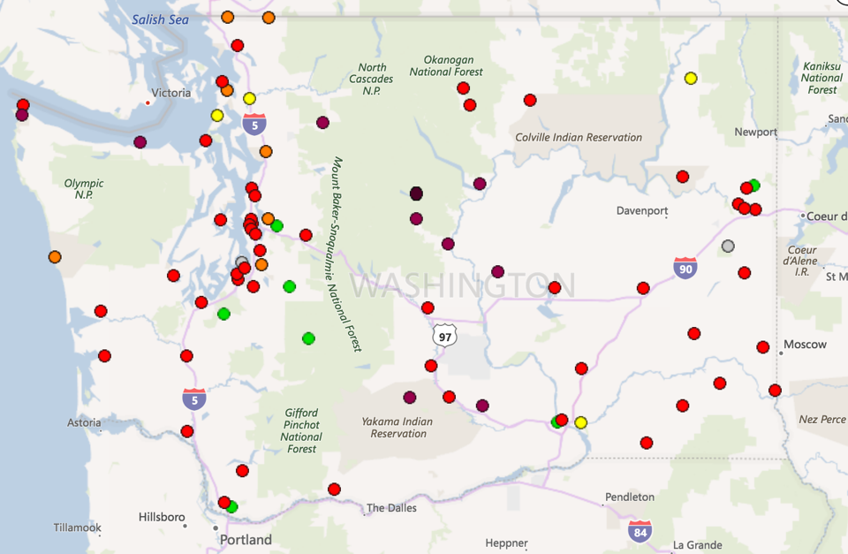
Government Air Monitors in Washington State on 8/14/18
Notes:
Here are many of the government air monitors in Washington. Where do you notice more air monitors? Fewer air monitors?
(Urban vs. rural/less urban)
Green=good air quality, yellow=moderate, and gray=monitors not working. Orange, red, purple, and dark purple=varying degrees of unhealthy.
This snapshot is from 8/14/18. What do you think was going on at that time to cause this air quality?
(wildfires)
Image from the Washington State Department of Ecology air monitoring website. Current site: https://enviwa.ecology.wa.gov/home/map

Slide 4
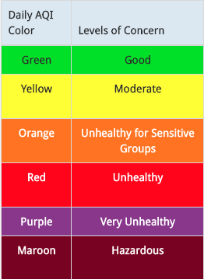
Air Quality Index (AQI)
The Air Quality Index is a rating system used by the Environmental Protection Agency. The rating depends on several different types of air pollution that are monitored. One type of air pollution monitored is particulate matter.
Notes:
Table modified from the EPA AirNow website: https://www.airnow.gov/aqi/aqi-basics/

Slide 5
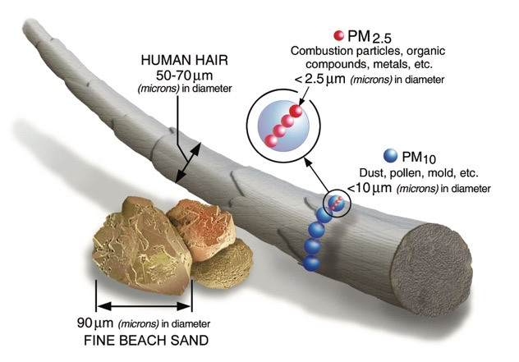
PM_{2.5} and PM₁₀
Particulate matter (PM) comes in different sizes. The sizes that are usually monitored are PM with a diameter less than 10 micrometers (PM₁₀) or less than 2.5 micrometers (PM_{2.5}).
Notes:
Particulate Matter: Particulate matter, or PM, is the term for small particles found in the air including dust, dirt, soot, smoke, and liquid droplets. Particles can be suspended in the air for long periods of time.
Image from the EPA: https://www.epa.gov/pm-pollution/particulate-matter-pm-basics#PM

Slide 6
Activity
Go to the Washington State Department of Ecology air monitoring map:
https://enviwa.ecology.wa.gov/home/map
WAQA=Washington Air Quality Advisory and is a different version of the Air Quality Index (AQI)
Which air monitor are you looking at?
What is the WAQA rating for the monitor you’re looking at?
Which air pollutants are being monitored?

Slide 7
Notes:
Image from the Washington State Department of Ecology website: https://fortress.wa.gov/ecy/publications/documents/1802024.pdf
More information on WAQA: ecology.wa.gov/WAQA

Slide 8
Activity
Go to the world air quality index map:
https://waqi.info/
You can zoom in on a particular area for more detail
What parts of the world have a worse air quality index right now? Better?
What parts of the world have more air monitors? Fewer?

Slide 9
Purple Air introduction
Notes:
Photo by Amanda Virbitsky

Slide 10
The Purple Air Monitor measures the number of particles per 0.1 liters of air sampled. 0.1 liters is similar in size to the volume of 2 medium-size chicken eggs. The monitor detects the number of particles per 0.1 liter of air that fall into different size ranges, or bins.
Notes:
Eggs: cropped photo by Debby Hudson on Unsplash

Slide 11
The monitor detects the number of particles per 0.1 liter of air that fall into different size ranges, or bins.
Bin #1: >0.3 µm
Bin #2: >0.5 µm
Bin #3: >1 µm
Bin #4: >2.5 µm
Bin #5: >5 µm
2.5 µm
0.5 µm
10 µm
Bin #6: >10 µm
>0.3 µm
1 µm
5 µm
>10 µm

Slide 12
Particle Mass
Based on the particle count, the Purple Air Monitor calculates an estimate of the mass concentration of particles that have a diameter less than:
1 µm → PM₁
2.5 µm → PM_{2.5}
10 µm → PM₁₀
The mass concentration units are micrograms/cubic meter.
1 cubic meter = 1000 liters
1000 X
Notes:
Image from Instacart

Slide 13
Some requirements for the site where the Purple Air Monitor will work
Needs to be plugged in
Indoors or outdoors
Must have permission to place a monitor
Needs to be in a secure location

Slide 14
Activity
Where would you want to put Purple Air monitors?
Go to the Purple Air website:
https://www2.purpleair.com/pages/install
What do you need to keep in mind when deciding where might be good places to put the Purple Air monitors?
Where would you want to put the monitors? Why? Where do you want to learn more about the air quality?

Slide 15
Particle sizes and light scattering
Notes:
Photo by Amanda Virbitsky

Slide 16
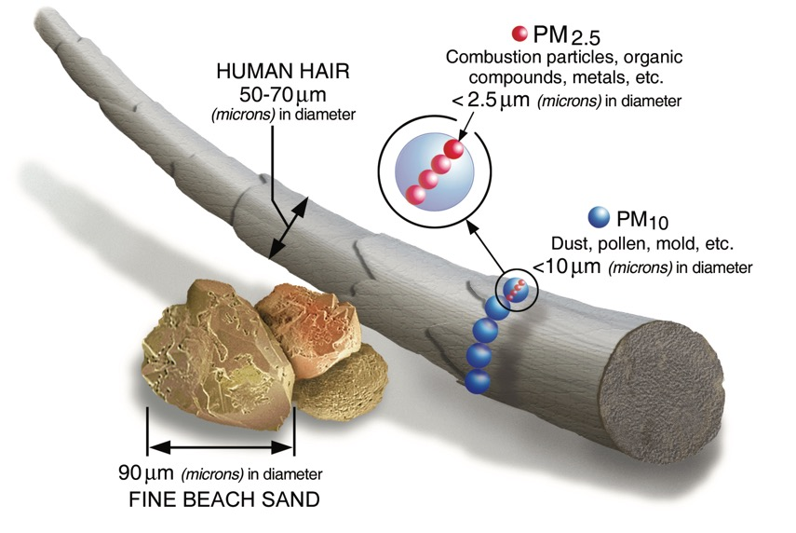
Review: Particle Sizes
Notes:
Particulate Matter: Particulate matter, or PM, is the term for small particles found in the air including dust, dirt, soot, smoke, and liquid droplets. Particles can be suspended in the air for long periods of time.
Particulate matter (PM) comes in different sizes. The sizes that are usually monitored are PM with a diameter less than 10 micrometers (PM₁₀) or less than 2.5 micrometers (PM_{2.5}).
Image from the EPA: https://www.epa.gov/pm-pollution/particulate-matter-pm-basics#PM

Slide 17
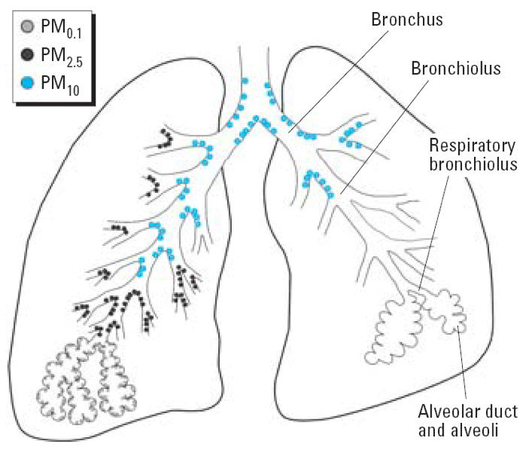
Why are particle sizes important?
Notes:
Particles smaller than 10µm can get past the nose and upper respiratory defenses. These small particles can penetrate deep into the lungs. Very small particles can enter the bloodstream and impact the heart and brain.
This figure is from: Cormier, S. A., Lomnicki, S., Backes, W., & Dellinger, B. (2006). Origin and health impacts of emissions of toxic by-products and fine particles from combustion and thermal treatment of hazardous wastes and materials. Environmental Health Perspectives, 810-817.

Slide 18
How does the monitor count particles? 1. The air containing the particles passes through a beam of light. 2. Particles of different sizes cause the light to scatter in different ways. 3. The way the light scatters is detected and used to calculate the number of particles of different sizes.
Particles
Beam of light
Amount of light scatter

Slide 19
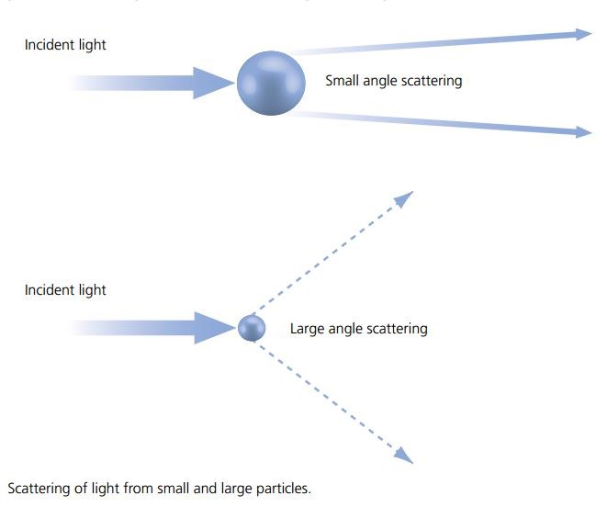
Light scattering
Notes:
Here is another example of the same idea.
Image from: https://www.azom.com/article.aspx?ArticleID=9937

Slide 20
Sources of particulate matter
Notes:
Photo by Amanda Virbitsky

Slide 21
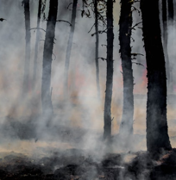
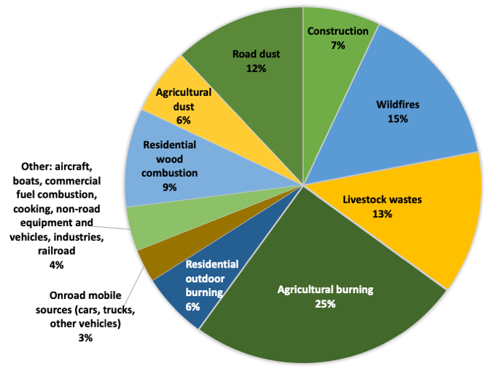
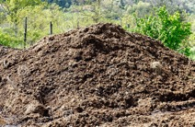
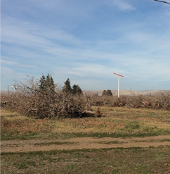
Where does particulate matter come from in Yakima County?
Estimates of fine particulate matter (PM_{2.5}) sources in Yakima County
Notes:
Note that dominant sources of PM2.5 can vary a lot by location. The types of dominant sources in Yakima County may be very different from the sources in other areas.
Data from the Washington State Department of Ecology Washington State 2014 County Emissions Inventory: https://ecology.wa.gov/DOE/files/c1/c1c6608a-65ed-46a4-aef9-67da5fe3c54d.pdf
Burn piles: Photo by Orly Stampfer
Smoke stacks: Photo from the University of Washington Department of Environmental and Occupational Health Sciences
Manure: Photo by Leon Viti from Dreamstime.com (https://www.dreamstime.com/leon1_info)
Road dust: Image by sandid from Pixabay
Truck: Photo by Matthew T Rader on Unsplash
Wildfire: Photo by Joanne Francis on Unsplash
Wood stove: Photo by Michael Shannon on Unsplash

Slide 22
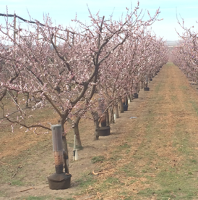
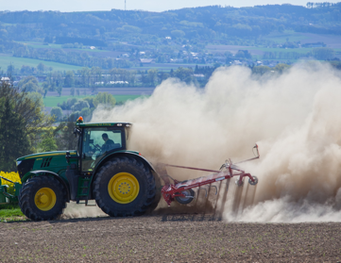
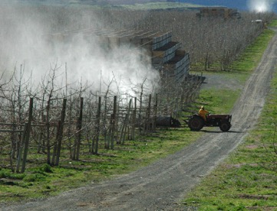
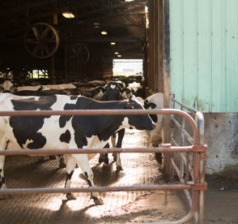
Examples of particle pollution from current agriculture
Smudge pots/orchard heaters
Diesel-powered machinery
Dust
Pesticides
Fertilizer
Notes:
Tractor in orchard photo from the University of Washington Department of Environmental and Occupational Health Sciences.
Dairy photo from the University of Washington School of Public Health
Orchard heater photo by Orly Stampfer
Tractor in field photo by Hermann Kollinger from Pixabay

Slide 23
Activity
Make three lists on the board for each of the three areas:
White Swan
Harrah
Toppenish
Brainstorm as a group different sources of particulate matter that you think are present in these three areas. For sources that you think are larger, add a little plus sign next to them. For sources that you think are smaller, add a little minus sign next to them. Feel free to look up information about particulate matter online to make your lists.

Slide 24
Air pollution and health
Notes:
Photo by Amanda Virbitsky

Slide 25
Air pollution and asthma
Air pollution is an asthma trigger, which means that if someone already has asthma, air pollution can cause their asthma to worsen.
Air pollution, especially from traffic, can cause asthma as well, especially if children are exposed to air pollution in-utero (before they are born) and in early life.

Slide 26
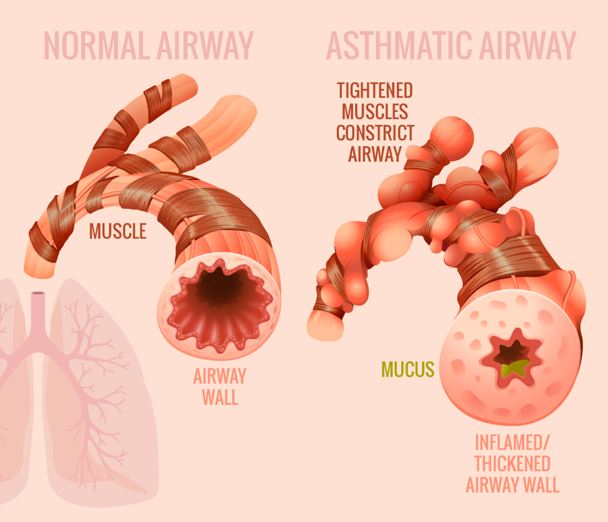
Notes:
Image from: https://asthma.net/causes/

Slide 27
Air pollution does not only affect the lungs and breathing. Air pollution also affects the ______, ______, and possibly other parts of the body as well.

Slide 28
Air pollution does not only affect the lungs and breathing. Air pollution also affects the heart, brain, and possibly other parts of the body as well.

Slide 29
Review: Why are particle sizes important?
Notes:
Particles smaller than 10µm can get past the nose and upper respiratory defenses. These small particles can penetrate deep into the lungs. Very small particles can enter the bloodstream and impact the heart and brain.
This figure is from: Cormier, S. A., Lomnicki, S., Backes, W., & Dellinger, B. (2006). Origin and health impacts of emissions of toxic by-products and fine particles from combustion and thermal treatment of hazardous wastes and materials. Environmental Health Perspectives, 810-817.

Slide 30
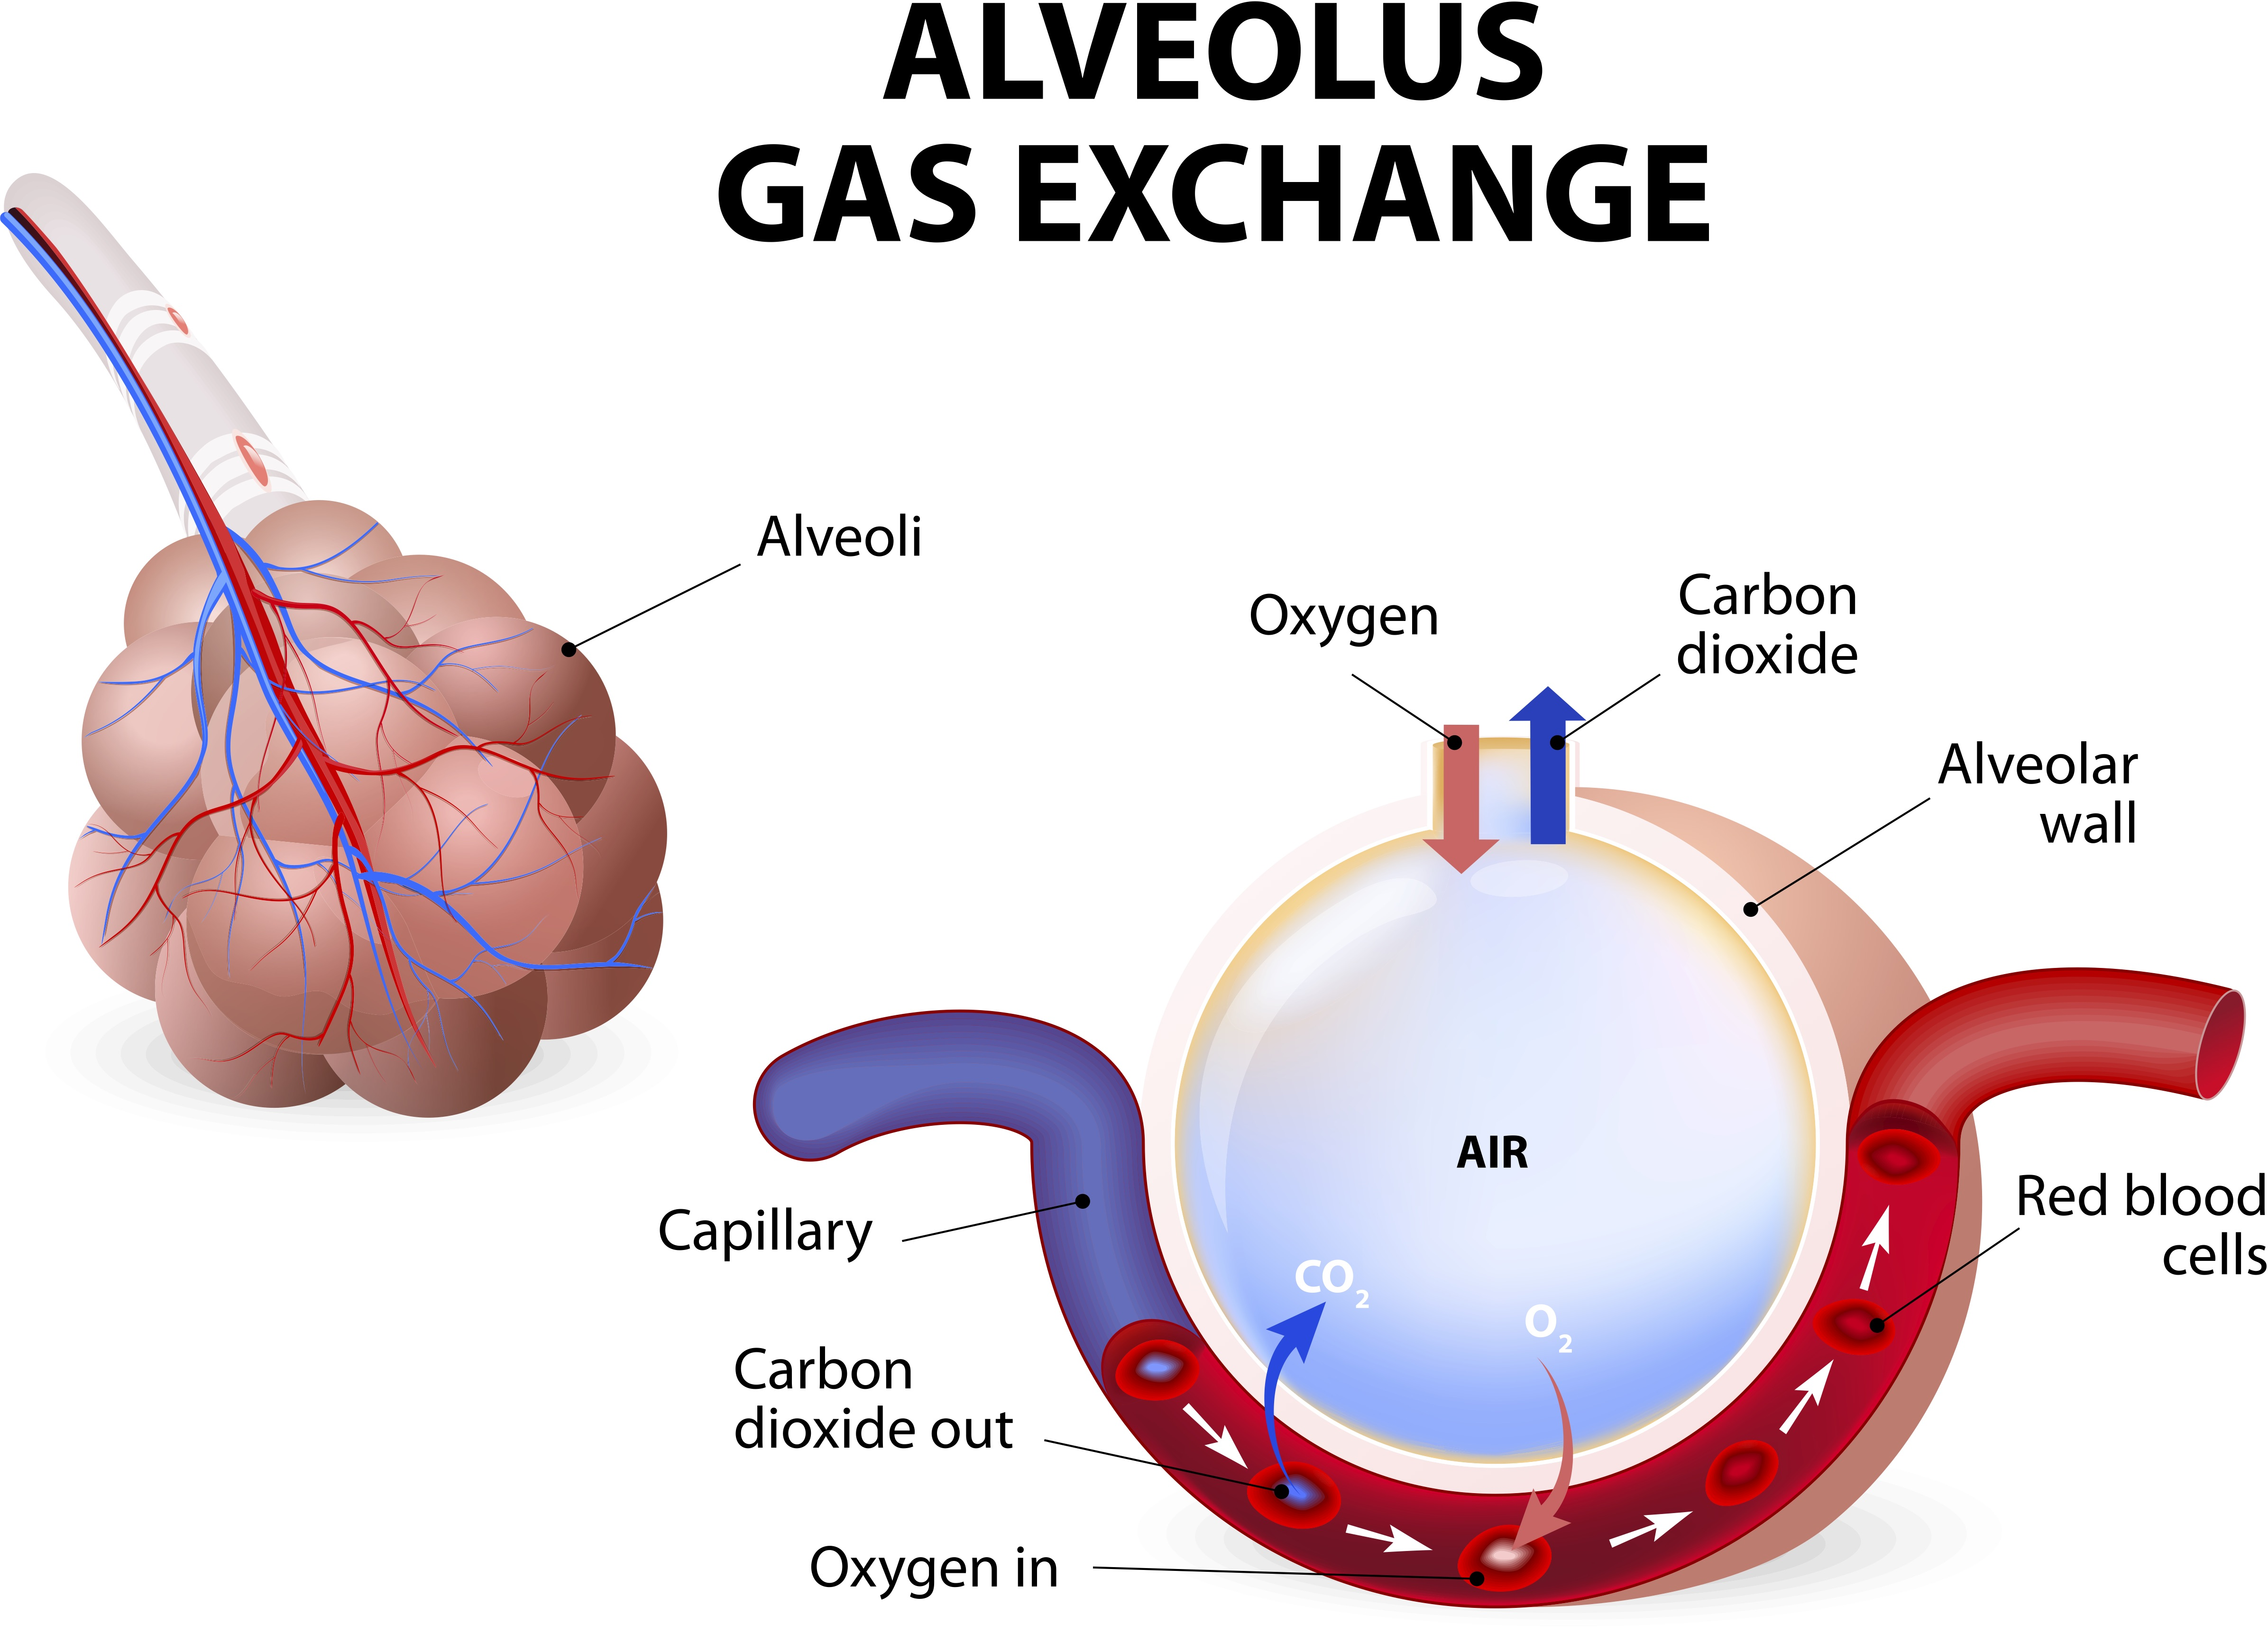
Alveolus gas exchange: Just like oxygen and carbon dioxide move between the lungs (alveoli) and blood, very small particles can also move into the blood.
Notes:
Image by Designua from Shutterstock.

Slide 31
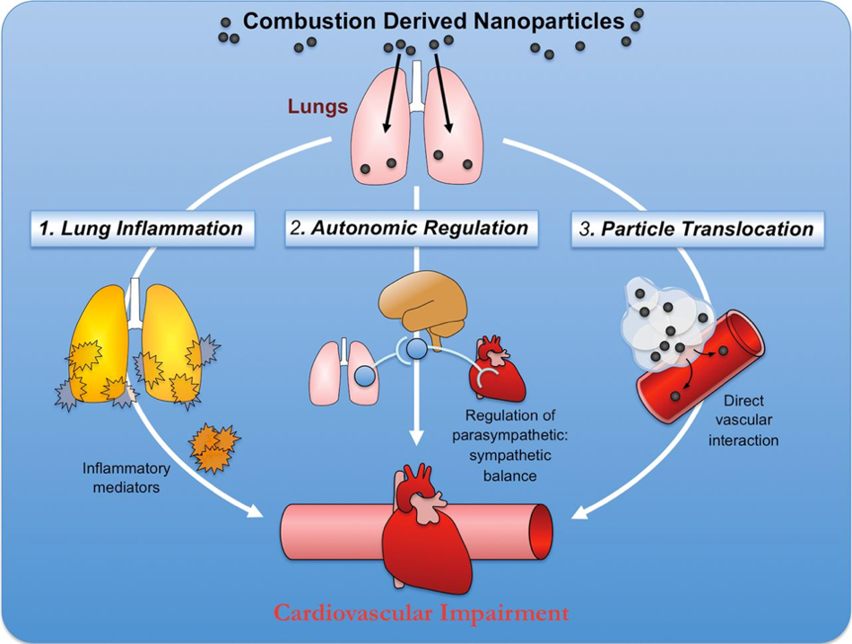
Particles
Particles directly impact the lining of the blood vessels
The way the brain regulates the heart and circulatory system is impacted
Products of inflammation
Notes:
Edited image from: http://www.biochemsoctrans.org/content/42/4/1006.figures-only

Slide 32
Particles
Lung tubes swell
Gunk clogs your blood vessels
Particles directly impact the lining of the blood vessels
The way the brain regulates the heart and circulatory system is impacted
Products of inflammation
Notes:
Edited image from: http://www.biochemsoctrans.org/content/42/4/1006.figures-only

Slide 33
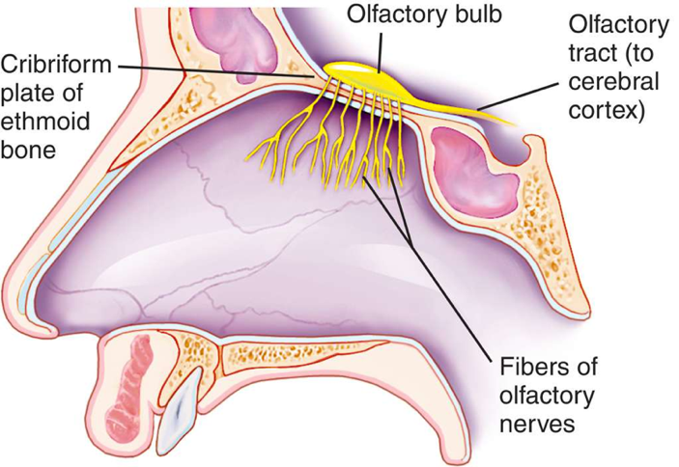
Very small particles can also reach the brain through the nose, which connects to the olfactory bulb – the part of our brain that senses smell.
Notes:
Edited image from: https://medical-dictionary.thefreedictionary.com/_/viewer.aspx?path=MosbyMD&name=olfactory-nerve.jpg&url=https%3A%2F%2Fmedical-dictionary.thefreedictionary.com%2Folfactory%2Bnerve

Slide 34
Air quality case study: Tacoma and Pierce County part 1
Notes:
Photo by Amanda Virbitsky

Slide 35
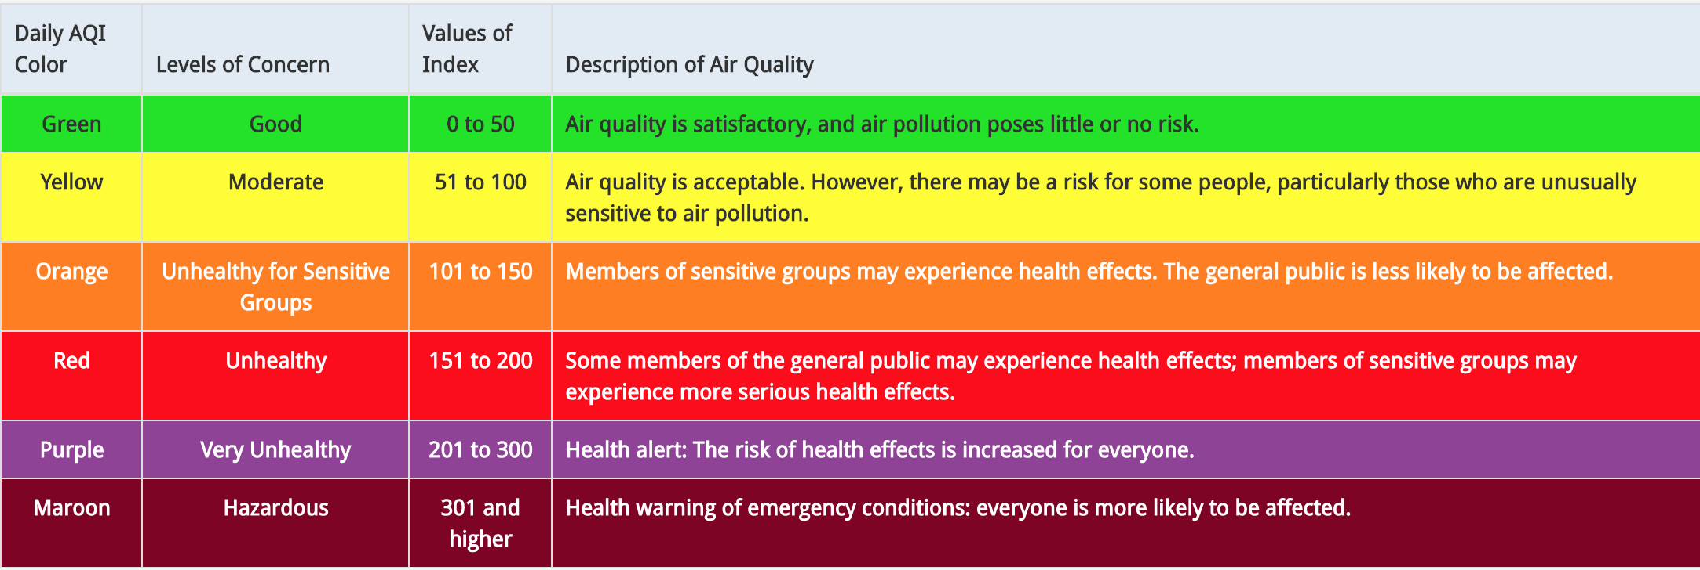
Remember this from the first week? This is the Air Quality Index. In most of WA, this rating is based mostly on the amount of particulate matter.
Local, state, federal, and Tribal agencies regulate the level of particulate matter allowed outside in order to maintain good air quality.
Notes:
Table from the EPA AirNow website: https://www.airnow.gov/aqi/aqi-basics/

Slide 36
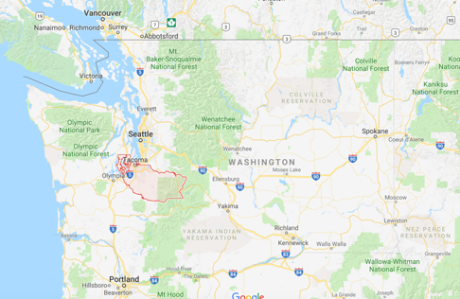
In 2009, the US Environmental Protection Agency designated Tacoma and part of Pierce County as being “nonattainment” which means they exceeded the National Ambient Air Quality Standard (NAAQS) for PM2.5.
Puget Sound Clean Air Agency is a local-level agency that helps regulate and maintain good air quality in King, Kitsap, Pierce, and Snohomish counties in western WA
Notes:
Images from Phil Swartzendruber, Puget Sound Clean Air Agency

Slide 37
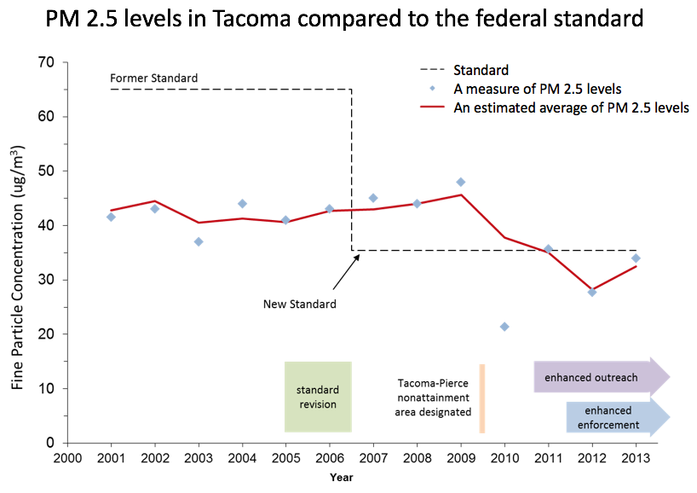
Notes:
Image/chart from Phil Swartzendruber, Puget Sound Clean Air Agency

Slide 38
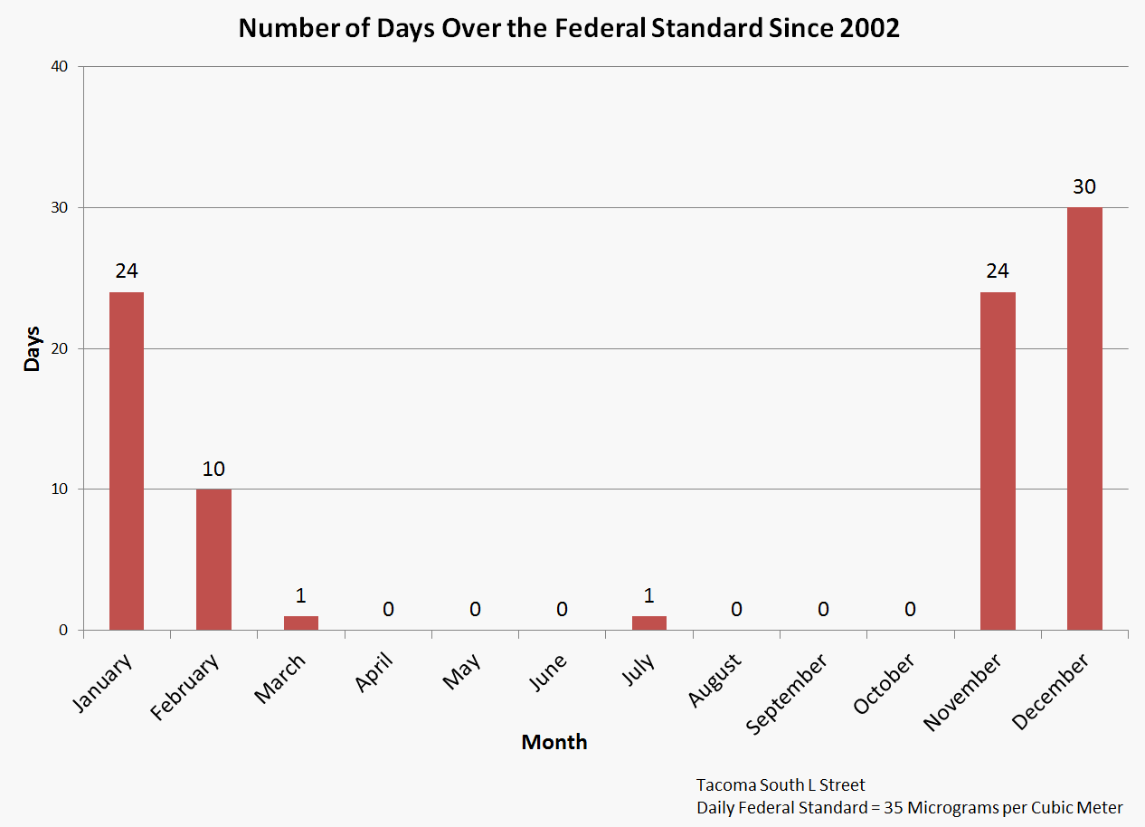
Other information:
In the winter, nighttime PM levels are higher than daytime
Tacoma is a major port
Pierce County is home to about 845,000 people
Notes:
Image/chart from Phil Swartzendruber, Puget Sound Clean Air Agency

Slide 39
Activity
Discussion questions:
What are some pollution sources that you think might be impacting Tacoma and Pierce County’s air quality?
Why do you think air quality might be worse in the winter?
Why do you think air quality might be worse at night?
Why do you think the federal government changed the PM_{2.5} standard (allowable level)?
How do you think air quality should be regulated?
If you were an air quality regulator, what kinds of questions would you ask? Who would you want to talk with?

Slide 40
Air quality case study: Tacoma and Pierce County part 2
Notes:
Reintroduce some of the discussion questions from the previous session.
Photo by Amanda Virbitsky

Slide 41
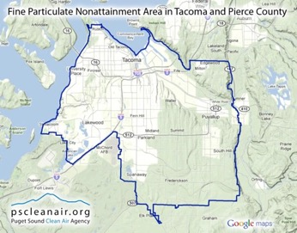
Last week we learned about how in 2009, the US Environmental Protection Agency designated Tacoma and part of Pierce County as being “nonattainment” which means they exceeded the National Ambient Air Quality Standard (NAAQS) for PM2.5
In the winter, nighttime PM levels were higher than daytime.
Nearly all of the days that the PM levels were higher than the federal standard occurred in January, February, November, and December.
Notes:
Images from Phil Swartzendruber, Puget Sound Clean Air Agency

Slide 42
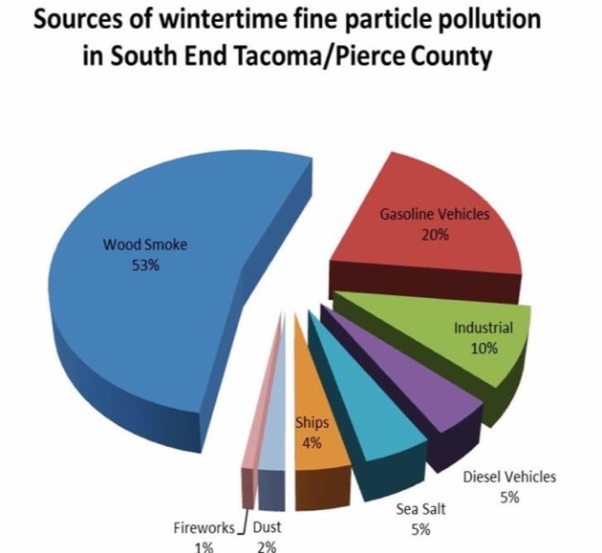
A majority of the wintertime PM in the Tacoma and Pierce County area was found to come from wood smoke. Puget Sound Clean Air Agency and the WA Department of Ecology convened a stakeholder working group to advise on solutions. The stakeholder group decided to focus on residential wood smoke.
Image from: Ogulei (2010)
Notes:
Image from: Ougulei, D. (2010), Sources of Fine Particles in the Wapato Hills-Puyallup River Valley PM2.5 Nonattainment Area, WA Dept of Ecology, April 2010, Publication No. 10-02-009.
Compare the pollution sources shown here to the ones we talked about last week and to the ones in the “Sources of particulate matter” section.
A majority of the wintertime PM in the Tacoma and Pierce County area was found to come from wood smoke.
Puget Sound Clean Air Agency and the WA Department of Ecology convened a stakeholder working group to advise on solutions.
The stakeholder group decided to focus on residential wood smoke and recommended: enhanced enforcement, expanded change-out programs, ban older (uncertified) stoves.

Slide 43
Recommendations for Tacoma and Pierce County:
Enhanced enforcement of burn bans (with exceptions for people with no other form of heat)
Ban uncertified wood stoves in the non-attainment area
Expanded wood stove change-out program to incentivize replacement of old wood stoves with a cleaner heating device (for free if needed, or at a discount)
Notes:
Image from Phil Swartzendruber, Puget Sound Clean Air Agency

Slide 44
Purple Air data
Notes:
Photo by Amanda Virbitsky

Slide 45
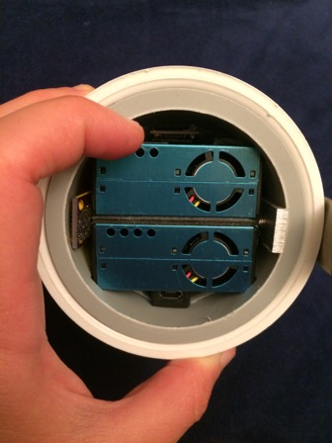
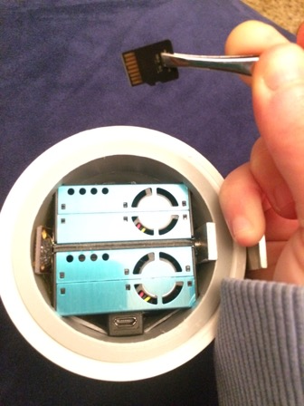
Each Purple Air monitor contains two sensors. These sensors are called Plantowers. The Plantowers measure the number of particles in the air that pass through the sensors, using light scattering. It’s hard to see, but also inside the Purple Air monitor is a chip board, the micro SD card, a temperature sensor, and a humidity sensor.
Micro SD card
One Plantower
Another Plantower
Inside: chip board, temperature sensor, humidity sensor
Notes:
Light scattering: review the spray bottle activity and the “Particle sizes and light scattering” section.
Photos by Orly Stampfer

Slide 46
The monitor detects the number of particles per 0.1 liter of air that fall into different size ranges, or bins.
Bin #1: >0.3 µm
Bin #2: >0.5 µm
Bin #3: >1 µm
Bin #4: >2.5 µm
Bin #5: >5 µm
2.5 µm
0.5 µm
10 µm
Bin #6: >10 µm
>0.3 µm
1 µm
5 µm
>10 µm
Notes:
Using light scattering, the Plantowers detect the number of particles per 0.1 liter of air that pass through the sensors. The Plantowers detect the number of particles of different sizes. The data on the micro SD card shows the number of particles detected that are greater than 0.3 micrometers (um) in diameter, greater than 0.5 um, greater than 1um, greater than 2.5 um, greater than 5um, and greater than 10 um. If you wanted to know the number of particles that were smaller than 2.5 um, you would need to take the number greater than 0.3 um and subtract the number greater than 2.5 um.

Slide 47
Particle Mass
Based on the particle count, the Purple Air Monitor calculates an estimate of the mass concentration of particles that have a diameter less than:
1 µm →PM₁
2.5 µm →PM_{2.5}
10 µm →PM₁₀
The mass concentration units are micrograms/cubic meter.
1 cubic meter = 1000 liters
1000 X
Notes:
The Purple Air monitor has a built-in equation to translate the number of particles of different sizes into estimates of the mass of particles of different sizes. The number of particles per 0.1 liters of air is translated to micrograms of particles per cubic meter of air. This is called the mass concentration. For example, on the previous slide we talked about how we would come up with the number of particles smaller than 2.5 um. In order to come up with a mass concentration for PM2.5, the Purple Air monitor applies an equation to the number of particles smaller than 2.5 um and this results in an estimate of the mass (micrograms) per meter cubed of particles smaller than 2.5 um. This is commonly referred to as PM2.5 (ug/m3). One meter cubed is equal to 1000 liters.
Image from Instacart

Slide 48
Coordinated Universal Time (7 or 8 hours ahead of us)
Temperature (degrees F)
Humidity (%)
Wifi address, version of firmware in use, hardware detected
Dewpoint and pressure (other weather info)
Voltage reading, memory, wifi signal strength, firmware time running
Estimates of mass conc. (ug/m3) of PM₁, PM_{2.5}, and PM₁₀ for Plantower a
Factory estimates of mass conc. (ug/m3) of PM₁, PM_{2.5}, and PM₁₀ for Plantower a
Number of particles detected per 0.1 liters of air for each bin size: >0.3um, >0.5um, >1um, >2.5um, >5um, and >10um for Plantower a
Estimates of mass conc. (ug/m3) of PM₁, PM_{2.5}, and PM₁₀ for Plantower b
Factory estimates of mass conc. (ug/m3) of PM₁, PM_{2.5}, and PM₁₀ for Plantower b
Number of particles detected per 0.1 liters of air for each bin size: >0.3um, >0.5um, >1um, >2.5um, >5um, and >10um for Plantower b
Notes:
These are all of the columns that appear in a spreadsheet of Purple Air data. Note that the time used is Coordinated Universal Time, which is 7 hours ahead of us during daylight savings (PDT), and 8 hours ahead of us during standard time (PST). Particle number and mass concentration data is provided twice – one set for each Plantower (Plantower a and Plantower b). There are two estimates for mass concentrations (PM1, PM2.5, and PM10) provided for each Plantower. The “cf” estimate is meant to be used in factory or laboratory environments. The “atm” estimate is meant to be used in everyday environments. The “atm” estimate is the one we will use in our projects.
Please note that Purple Air data downloaded from the internet or with more recent firmware updates may look different from what is shown here.

Slide 49
Forming hypotheses
Notes:
Photo by Amanda Virbitsky

Slide 50
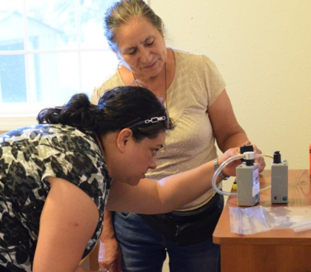
Hypotheses
What is a hypothesis?
An idea about a phenomenon that is testable
Why do we make hypotheses?
They help us figure out how to design our experiments
They help us figure out what data we should collect
Community air pollution researchers Elizabeth Torres and Carmen Mireles
Notes:
Photo by Catherine Karr

Slide 51
Dependent and independent variables
Scientists are often asking: how does a dependent variable change in relation to a change in an independent variable?
Examples of dependent variables include:
Air particle counts
Air particle mass
Air particle sizes
Examples of independent variables include:
Time
Place
Pollution sources
What else?
A hypothesis answers the question: what will happen to your dependent variable with changes in your independent variable, based on your background research?
Notes:
One way to think through this is to fill in the blank. For the first bullet point, replace “dependent” with one of the dependent variables given and replace “independent” with one of the independent variables given. For example: how does air particle mass concentration change in relation to a change in time?

Slide 52
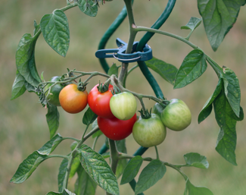
Hypothesis example
Independent variable:
soil calcium
Example: My hypothesis is that tomato plants that have calcium mixed into the soil will grow taller than tomato plants without calcium mixed into the soil.
This hypothesis guides me in figuring out how to design my experiment:
I’ll need at least two tomato plants
Dependent variable:
plant height
Plant them in soil that is the same except for half of them will have calcium mixed in
Make sure they have the same amount of light, heat, and water
Measure how tall they are at certain time intervals
Other variables that might impact the outcome
Notes:
Tomato plant photo: Image by Manfred Richter from Pixabay

Slide 53
Activity
Brainstorm questions:
What is your project topic?
Why are you interested in this topic?
What is your project hypothesis?
What data will you need to do this project?

Slide 54
Review of graphs
Notes:
Photo by Amanda Virbitsky

Slide 55
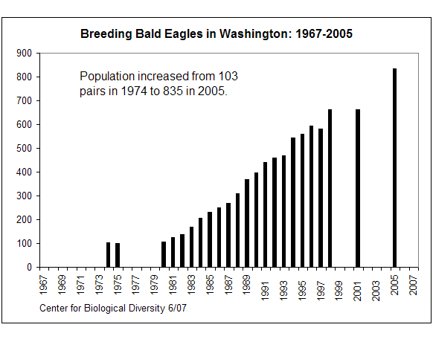
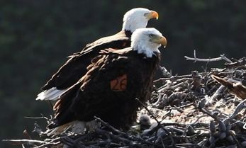
XY graphs show us patterns and relationships between two variables (x and y). This is the number of bald eagle breeding pairs observed in Washington each year from 1967-2005. In this case, as x (time) goes up, y (# bald eagle pairs) changes.
Number of bald eagle breeding pairs in WA
Year
y-axis: our dependent variable
x-axis: our independent variable
Notes:
Bald eagle pair chart from: https://www.biologicaldiversity.org/species/birds/bald_eagle/report/index.html#:~:text=The%20population%20has%20since%20grown,the%20Wabash%20and%20White%20rivers.&text=The%20bald%20eagle%20was%20formerly,loss%20and%20persecution%20(25).
Bald eagle pair photo: Image by skeeze from Pixabay

Slide 56
Activity
What can we tell from this graph?
What does the range of the x-axis tell you?
What does the range of the y-axis tell you?
If someone wanted to know how many bald eagle pairs were observed in Washington in 1995, what would you tell them?
In general, what is happening to the number of observed bald eagle pairs over time?
Notes:
X-axis range tells you which years are included
Y-axis range tells you that the number of bald eagle breeding pairs observed is between 0 and 900
In 1995, there were about 550 breeding pairs observed in Washington.
In general, the number of observed bald eagle pairs is increasing over time.

Slide 57
Activity
What can we NOT tell from this graph?
How many bald eagle breeding pairs were observed in Washington in 2003?
Why are there more bald eagle pairs observed in later years compared to earlier years?
What are some other things that affect the number of bald eagle pairs observed?
Notes:
How many bald eagle breeding pairs were observed in Washington in 2003? This chart is missing data from 2003. You could guess that the number for 2003 might fall somewhere between the numbers for 2001 and 2005, but you can’t tell from this graph.
Why are there more bald eagle pairs observed in later years compared to earlier years? You might know an answer to this, but you can’t know it from the graph.
What are some other things that affect the number of bald eagle pairs observed?

Slide 58
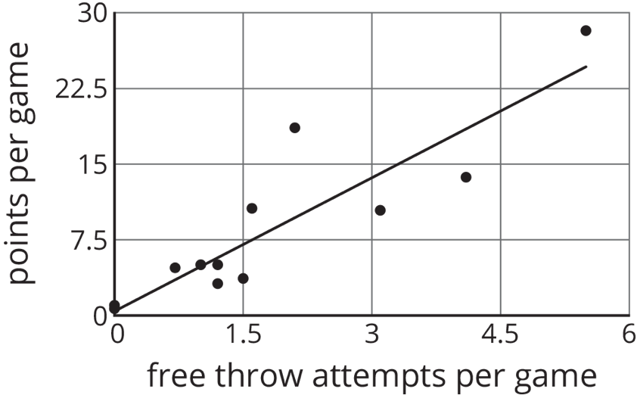
This graph is showing the average # of points per game vs. the average # of free throw attempts per game for different players in a basketball tournament. The line shown is a trend line, showing the average relationship between x (free throw attempts) and y (points per game).
Notes:
Graph from: https://curriculum.illustrativemathematics.org/MS/students/3/6/4/practice.html
Basketball photo: Image by Keith Johnston from Pixabay

Slide 59
Activity
What can we tell from this graph?
What do the number of dots tell you?
What does the range of the x-axis tell you?
What does the range of the y-axis tell you?
If someone had an average of 3 free throw attempts per game, how many average points per game would you expect, based on the trend line?
Notes:
# dots = there were 11 or 12 players in this sample.
x-axis range tells you that the average number of free throw attempts is between 0 and 6
y-axis range tells you that the average number of points is between 0 and 30
3 free throw attempts per game expect around 14 points.

Slide 60
Activity
What can we NOT tell from this graph?
If someone had an average of 10 free throw attempts per game, how many average points per game would you expect?
Why do average points per game go up when average free throw attempts go up?
What are some other things that affect average points per game?
Notes:
If someone had an average of 10 free throw attempts per game, how many average points per game would you expect? The trend line doesn’t go out that far. You could make a guess of whether or not you think the relationship will stay the same for that many free throw attempts.
Why do average points per game go up when average free throw attempts go up? You might know an answer to this, but you can’t know it from the graph.
What are some other things that affect average points per game?

Slide 61
Discussion and drawing
Write down at least 1 idea of graphs you could make for your project. Draw a sketch of what you think your graph might look like.
Remember that the independent variable goes on the x-axis and the dependent variable goes on the y-axis. Recall from last week:
Scientists are often asking: how does a dependent variable change in relation to a change in an independent variable?
Examples of dependent variables include:
Air particle counts
Air particle mass
Air particle sizes
Examples of independent variables include:
Time
Place
Pollution sources
Activity

Slide 62
Time scales
Notes:
Photo by Amanda Virbitsky

Slide 63
Review:
What is PM_{2.5}?
Why is PM_{2.5} a problem?
Where does PM_{2.5} come from?
Notes:
Particulate Matter: Particulate matter, or PM, is the term for small particles found in the air including dust, dirt, soot, smoke, and liquid droplets. Particles can be suspended in the air for long periods of time.
Particulate matter (PM) comes in different sizes. The sizes that are usually monitored are PM with a diameter less than 10 micrometers (PM₁₀) or less than 2.5 micrometers (PM_{2.5}).
If needed, review “Sources of particulate matter” and “Air pollution and health” sections.
Image from the EPA: https://www.epa.gov/pm-pollution/particulate-matter-pm-basics#PM

Slide 64
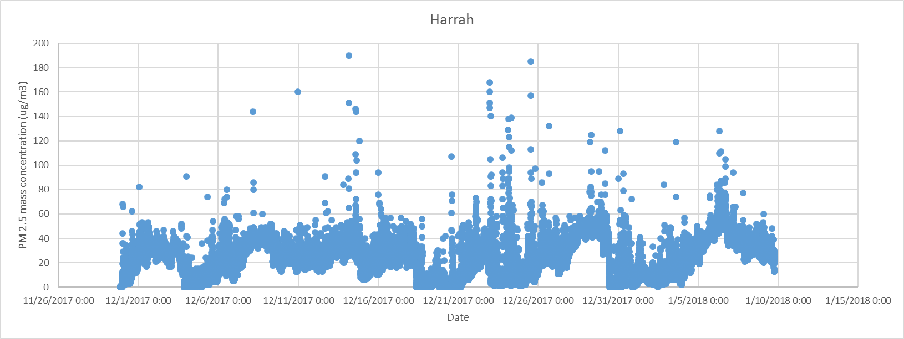
This is a graph of the PM_{2.5} mass concentration in Harrah over the time period from 11/29/17 to 1/9/18 (about 6 weeks).

Slide 65
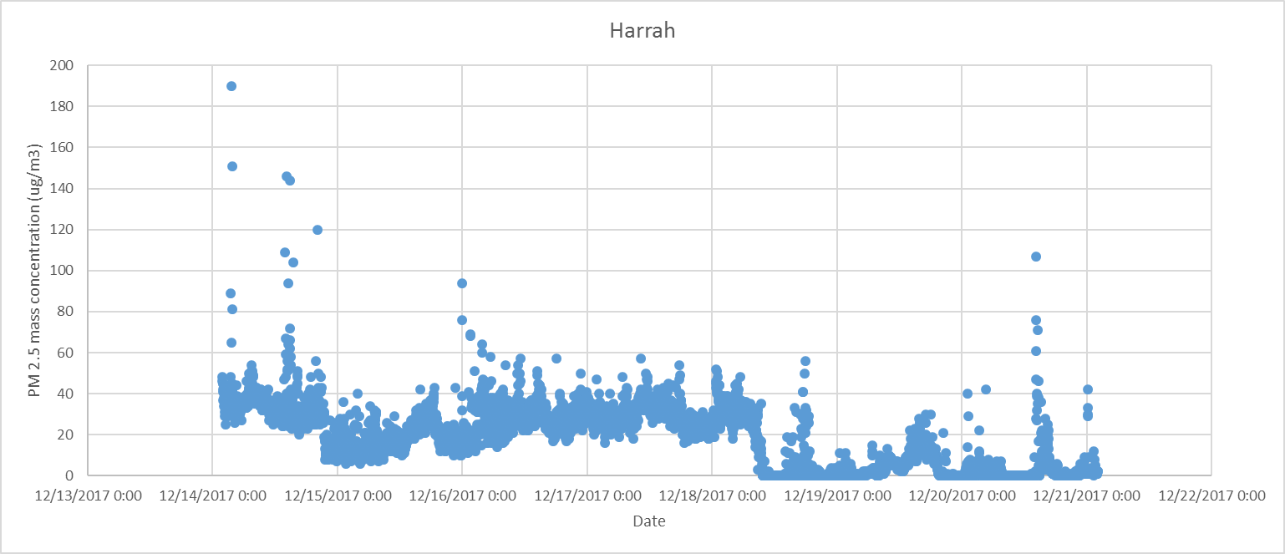
This is a graph of the PM_{2.5} mass concentration in Harrah over the time period from 12/14/17 to 12/21/17 (about 1 week).

Slide 66
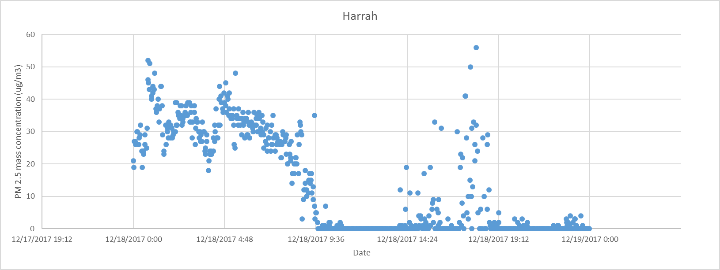
This is a graph of the PM_{2.5} mass concentration in Harrah over the time period from midnight on 12/18/17 to midnight on 12/19/17 (1 day).

Slide 67
Discussion
Pair up with your mentors and review the 3 graphs. What do the axes tell you?
Imagine you work for an environmental program, and they have asked you to investigate air quality in Harrah.
What information do the graphs show you?
What patterns do you see?
What do you want to know more about?
What guesses or thoughts do you have?
What would be the most useful time periods for you to look at for your project?
Activity

